Slide 1

Reducing the Dimensionality of Data with Neural Networks
by G. E. Hinton, and R. R. Salakhutdinov
Science
Volume 313(5786):504-507
July 28, 2006
Published by AAAS

Slide 2
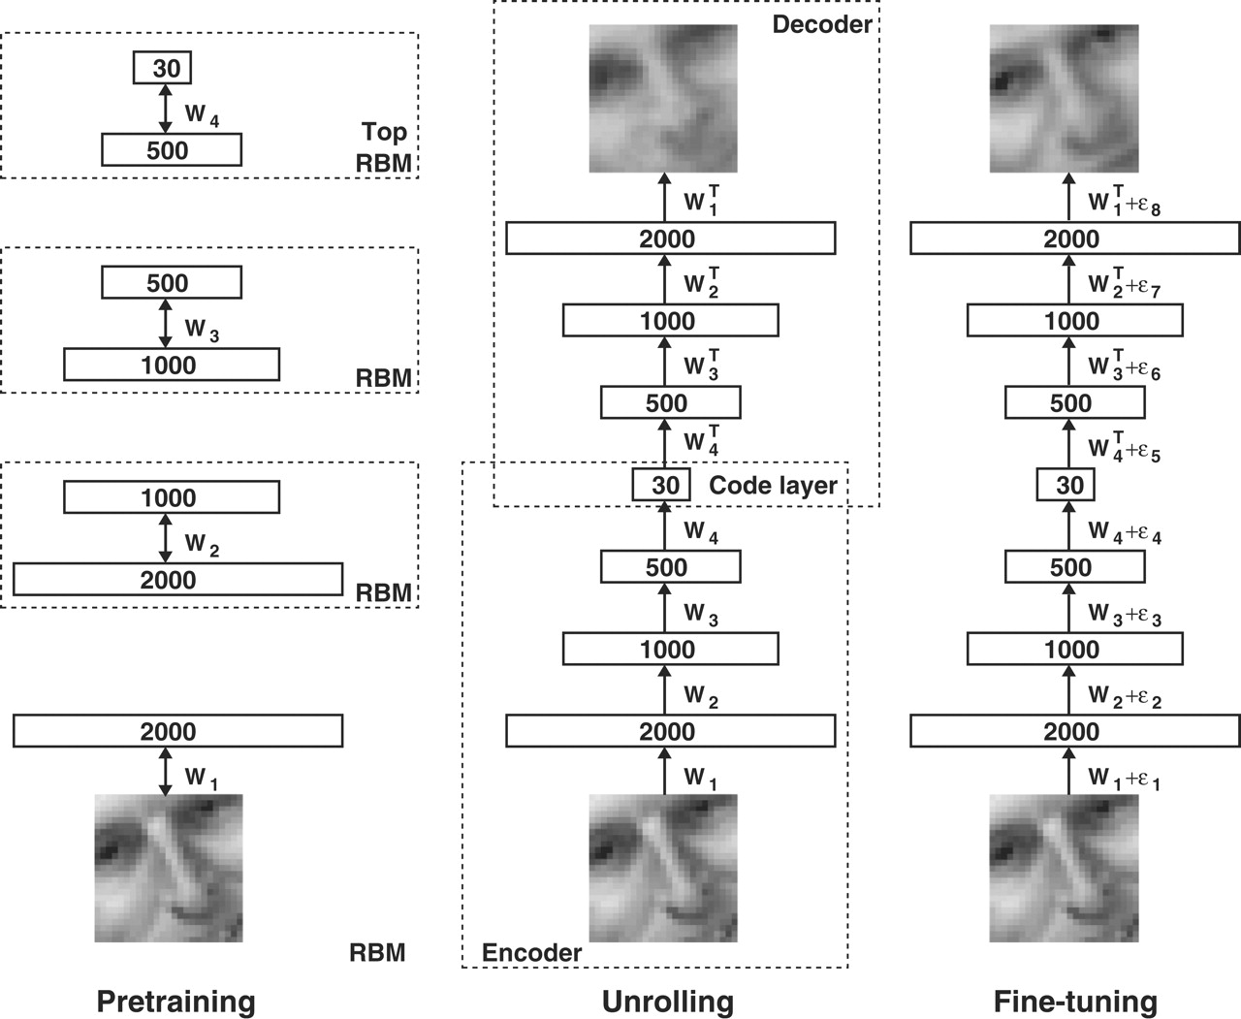
Fig. 1. Pretraining consists of learning a stack of restricted Boltzmann machines (RBMs), each having only one layer of feature detectors.
G. E. Hinton, and R. R. Salakhutdinov Science 2006;313:504-507
Published by AAAS
Notes:
Pretraining consists of learning a stack of restricted Boltzmann machines (RBMs), each having only one layer of feature detectors. The learned feature activations of one RBM are used as the “data” for training the next RBM in the stack. After the pretraining, the RBMs are “unrolled” to create a deep autoencoder, which is then fine-tuned using backpropagation of error derivatives.

Slide 3
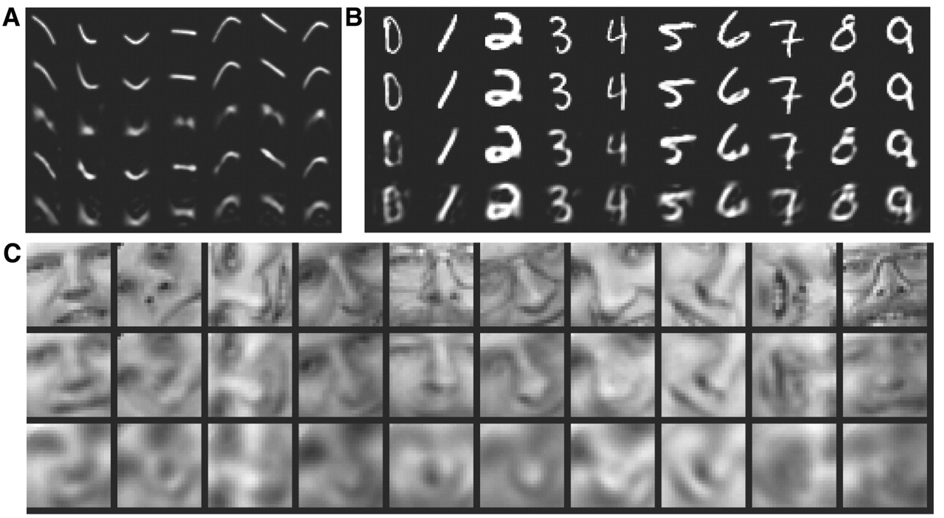
Fig. 2. (A) Top to bottom: Random samples of curves from the test data set; reconstructions produced by the six-dimensional deep autoencoder; reconstructions by “logistic PCA” (8) using six components; reconstructions by logistic PCA and standard PCA using 18 components.
G. E. Hinton, and R. R. Salakhutdinov Science 2006;313:504-507
Published by AAAS
Notes:
(A) Top to bottom: Random samples of curves from the test data set; reconstructions produced by the six-dimensional deep autoencoder; reconstructions by “logistic PCA” (8) using six components; reconstructions by logistic PCA and standard PCA using 18 components. The average squared error per image for the last four rows is 1.44, 7.64, 2.45, 5.90. (B) Top to bottom: A random test image from each class; reconstructions by the 30-dimensional autoencoder; reconstructions by 30-dimensional logistic PCA and standard PCA. The average squared errors for the last three rows are 3.00, 8.01, and 13.87. (C) Top to bottom: Random samples from the test data set; reconstructions by the 30-dimensional autoencoder; reconstructions by 30-dimensional PCA. The average squared errors are 126 and 135.

Slide 4
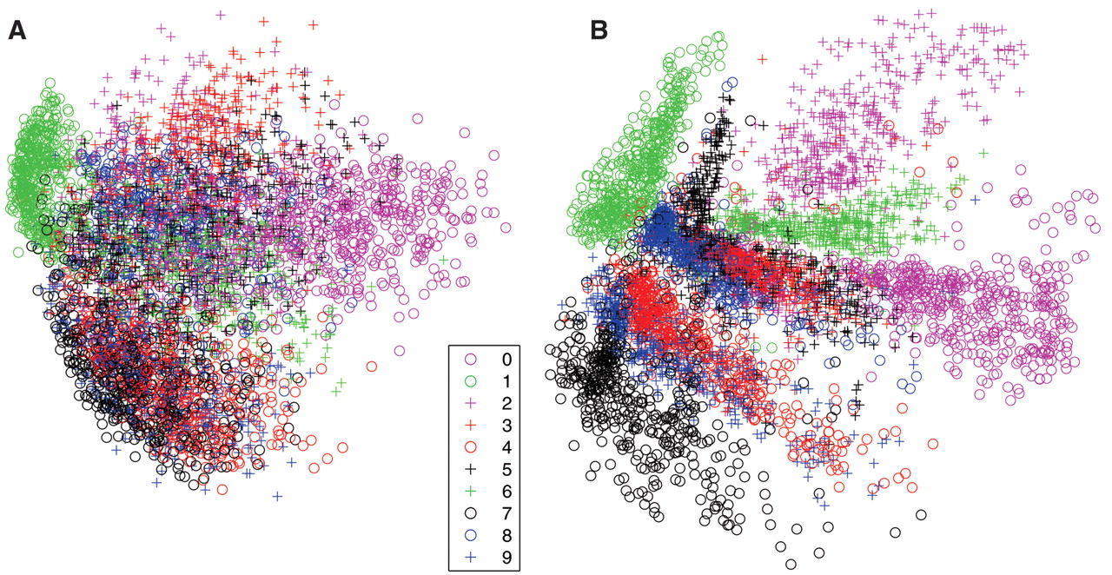
Fig. 3. (A) The two-dimensional codes for 500 digits of each class produced by taking the first two principal components of all 60,000 training images.
G. E. Hinton, and R. R. Salakhutdinov Science 2006;313:504-507
Published by AAAS
Notes:
(A) The two-dimensional codes for 500 digits of each class produced by taking the first two principal components of all 60,000 training images. (B) The two-dimensional codes found by a 784-1000-500-250-2 autoencoder. For an alternative visualization, see (8).

Slide 5
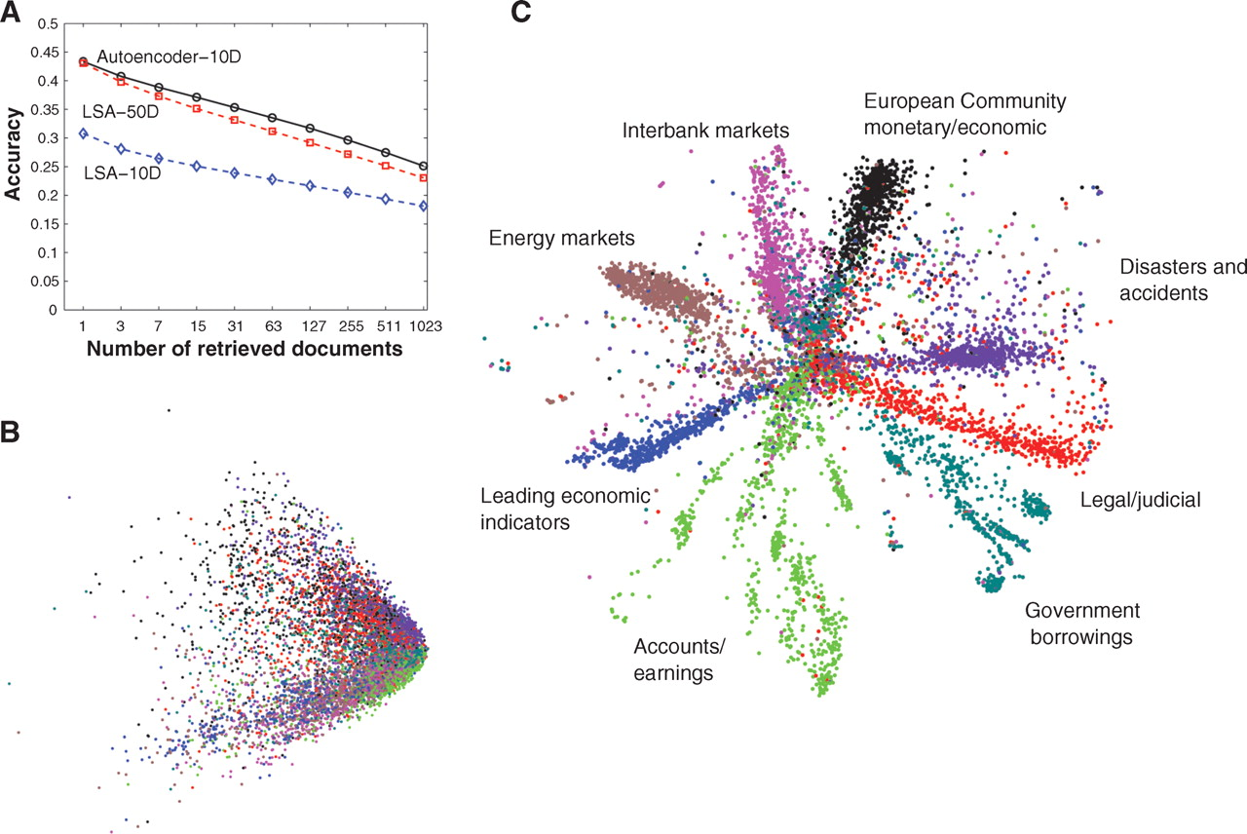
Fig. 4. (A) The fraction of retrieved documents in the same class as the query when a query document from the test set is used to retrieve other test set documents, averaged over all 402,207 possible queries.
G. E. Hinton, and R. R. Salakhutdinov Science 2006;313:504-507
Published by AAAS
Notes:
(A) The fraction of retrieved documents in the same class as the query when a query document from the test set is used to retrieve other test set documents, averaged over all 402,207 possible queries. (B) The codes produced by two-dimensional LSA. (C) The codes produced by a 2000-500-250-125-2 autoencoder.

